Slide 1
5. Stepping-Stone Intrusion Detection
Intrusion Detection Module
Stephen Huang
Department of Computer Science
University of Houston

Slide 2
Contents
Introduction
Stepping-Stone Detection
Stepping-Stone Correlation
Protection at the End of the Chain

Slide 3
Security
Hacker,
Identity Theft,
Privacy,
National Infrastructure

Slide 4
Direct Attack

Slide 5
Direct Attack
From: 111.22.33.44
To: 555.66.77.88
xxxxxxxxxxxx

Slide 6
Stepping Stone

Slide 7
Stepping Stone Detection
Examine the contents
Encrypted communication made it more difficult
Compare correlated packet patterns

Slide 8


Stepping-Stone Detection
………………

Slide 9
Contents
Introduction
Stepping-Stone Detection
Stepping-Stone Correlation
Protection at the End of the Chain

Slide 10
Assumptions
TELNET or Secured Shell (SSH) connections,
There is no valid reason to telnet through 4-5 hosts to reach a destination,

Slide 11
Connection Chain
Host
0
Host
i-1
Host
i
Host
i+1
Host
T
Hacker
Target Victim
Upstream Downstream
Figure 1: A Sample Connecting Chain

Slide 12
Connection Chain
Upstream Downstream
Host
0
Host
1
Host
2
Host
3
Host
4

Slide 13
Connection Chain
Upstream Downstream
Host
0
Host
1
Host
2
Host
3
Host
4

Slide 14
Connection Chain
Upstream Downstream
Host
0
Host
1
Host
2
Host
3
Host
4

Slide 15
Connection Chain
Upstream Downstream
Host
0
Host
1
Host
2
Host
3
Host
4

Slide 16
Connection Chain
Upstream Downstream
Host
0
Host
1
Host
2
Host
3
Host
4

Slide 17
Previous Work [Yung02]
RTT: the roundtrip time for a packet to travel from the host to the target machine and (echo) back,
RN: the acknowledge time from this host to the next host,
# Roundtrip Hosts = RTT / RN,
Does not work very well.

Slide 18
Problems
Not accurate estimation,
Not real-time algorithm,
Depends on network traffic,
Depends on host CPU utilization, processor speed, etc.

Slide 19
Our Objective
Real-time algorithm,
More accurate estimation,

Slide 20
Our Approach
Use the changes in the roundtrip time to detect a new connection,

Slide 25
Why is it better?

Slide 26
TCP Packet Types
FIN: to end a TCP session,
SYN: to start a TCP session,
RST: to drop a TCP connection,
PSH: to sent the packet immediately,
ACK: to acknowledge a packet, and
URG: to signal an urgent packet.

Slide 27
Logical Types
SEND (PSH): Send a packet to the next host
ECHO (PSH): Echo one or more packets
ACKnowledge (ACK): If there is a delay in sending ECHO, for one or more packets

Slide 28
Simple Patterns
Send
Echo
Ack

Slide 29
Packet Pattern 1
Matches all unmatched SEND packets
Send
Echo
Ack

Slide 30
Packet Pattern 2
Acknowledge all un-ACK ECHO packets
Send
Echo
Ack

Slide 31
Packet Pattern 3
ACKnowledging the result packets from the next server
Send
Echo
Ack

Slide 32
Our Assumptions
Ignore Acknowledgement packets
Ignore result packets
Only match echo packet with send packets

Slide 33
Algorithm 1
Initialize a queue Q to save outgoing packet;
while (the monitored port is connected) {
P = sniff the next packet;
if (P is a Send packet) Q.enqueue(P);
else if (P is an Echo packet){
// matching P with packet R in Q
while (Q is not empty) {
R = Q.dequeue();
if(match(P, R)) compute roundtrip time RT;
save RT into array RTime[];
}
if (Q.empty() and P has no match)
report error;
}
check RTime[] to estimate the number of hosts;
}

Slide 34
Algorithm 2
threshold = average of some randomly selected values in a[];
for (each element a[i], i>=5) {
minLeft = min(a[$i-5], a[$i-4], a[$i-3]);
minRight = min(a[$i-2], a[$i-1], a[$i]);
diff = minRight – minLeft;
if (diff > 0) { jumpDir="up"; }
else {
diff *= -1;
jumpDir = "down";
}
if (diff > threshold) {
jump between a[i-3] and a[i-2];
}
}

Slide 35
Windows Algorithm

Slide 36
Problem

Slide 37
Windows Algorithm Exam 1

Slide 38
Windows Algorithm Exam 1

Slide 39
Windows Algorithm Exam 1

Slide 40
Windows Algorithm Exam 1

Slide 41
Windows Algorithm Exam 2

Slide 42
Windows Algorithm Exam 2

Slide 43
Windows Algorithm Exam 2

Slide 44
Windows Algorithm Exam 3

Slide 45
Roundtrip Variation

Slide 46
Data Mining
Can we determine the number of hosts from the variation?

Slide 47
Conclusions
We have proposed a more accurate estimation of connection chain,
The algorithm is real-time,
How about upstream?
More hidden information?

Slide 48
Contents
Introduction
Stepping-Stone Detection
Stepping-Stone Correlation
Protection at the End of the Chain

Slide 49
Stepping-Stone Correlation
Connection Chain
  A set of connections created by sequentially logging into a series of intermediate hosts
Stepping-Stone host
  An intermediate host on the connection chain
Connection Pair
  Any two connections that are part of a connection chain
Connection Chain
Connection Pair
Intruder
Target
H₀
H₁
H₂
H_{i}
H_{n-1}
H_{n}
Upstream connections to H_{i}
Downstream connections to H_{i}
Notes:
The intruder establishes the connection sessions with the target machine, then the sequence of connection sessions forms a connection chain
All the intermediate hosts are the stepping-stone hosts
Any two connections along the chain form a connection pair. A connection pair may or may not be adjacent to each other.
Given a host H_{i} in a chain, a connection H_{j} → H_{j+1} is considered as an upstream connection to H_{i} if j < i.
Analogically, a connection H_{j} → H_{j+1} is considered as a downstream connection to H_{i} if j > i.

Slide 50
Matching Traffics to Identify Stepping-Stones
COMPARE
Incoming Stream
Outgoing Stream

Slide 51
Time Warping Based Approaches:
Measures “maximum similarity” between two sequences which may vary in time or speed.
  Allows to find an optimal match between two given sequences even if the sequences are "warped" non-linearly in the time axis
i
i
i
i
i+2
time
time
Any distance (Euclidean, Manhattan, …) which aligns the i-th point on one time series with the i-th point on the other may produce a poor similarity score.
A non-linear (elastic) alignment produces a more intuitive similarity measure, allowing similar shapes to match even if they are out of phase in the time axis.

Slide 52
Previous Method I:
Dynamic Time Warping (DTW)
Idea: locally recovers the “warped” time axis in order to minimize the local cumulative difference between the aligned points in two time series, and the possible alignments considered included all local compressions and shifts.
Example:
  R = {0, 1, 1, 2, 2, 3, 1, 0}
  T = {0, 1, 2, 3, 2, 1, 0, 1, 2}
Notes:
DTW uses the local distance d(i_{p,} o_{q}) plus the minimum of three given values DTW(p,q-1), DTW(p-1,q), DTW(p-1,q-1) to calculate DTW(p,q) repeatedly where p = 1, …, n and q = 1, …, m.
Standard dynamic time warping has the time complexity: O(nm), since all the possibilities need to be considered to ensure the optimal answer found. There are other techniques which speed up DTW.

Slide 53
Previous Method I:
Dynamic Time Warping (DTW)
Warping Function:
Time Series T
(Target)
1
q
m
To find the best alignment between R and T one needs to find the path through the grid
DTW(p,q) = (r_{p} , t_{q} )
which minimizes the total distance between them.
DTW demanded that every point on both time series had a match (many-to-many mapping)
Time complexity: O(nm).
1
Time Series R
(Reference)
p
DTW(p,q)
n
DIS (n,m)

Slide 54
Previous Method II:
Optimal Subsequence with Merge (OSSM)
Assume reference sequence is shorter than or equal to target sequence
This method compares sequence of intervals between two continuous packets
Idea:
  Uses the penalty function to skip the outliers on the reference stream, and
  Uses the merge operation to remove the outliers on the target stream
    “merge” groups the split intervals back to its original condition

Slide 55
If Dummy Packet Occurs…
DTW Algorithm increases the dissimilarity
  E.g.
OSSM has better matches
  Has the same dissimilarity with or W/O dummy packet
  By using merge function
  E.g.
merge

Slide 56
Previous Method:
Optimal Subsequence with Merge (OSSM)
Warping Function:
Time Series T
(Target)
1
q
m
1-1 mapping
w/o penalty
with penalty
Time Series R
(Reference)
1
 |  |  |  |  |  |  |  | O
OSSM(p,q)
p
OSSM assumes that both reference stream R and target stream T may contain outliers
  skips outliers in T with a penalty during the matching process (1-1 mapping)
Time complexity: O(n²m³).
n
Dis(I,O)
May not be at OSSM(n,m)

Slide 57
Problem of previous methods:
DTW
  Cannot cope with clock skew
  Cannot deal with chaff packet
OSSM
  Cope with some a limited amount of chaff
  Very high time complexity: OSSM: O(n²m³)

Slide 58
New Method I:
Dynamic Time Warping with Window (DTWW)
Giving a fixed time window:
  Reference Stream R: a subsequence of timestamps with the window from the end.
  Target Stream T: a subsequence of timestamps by using a sliding window operation on the upstream
  The sliding window has the start point with an increment of 1 second at a time.
Uses the DTW function to calculate the dissimilarity score for every pair of R and T.
The minimum dissimilarity score of all pairs is treated as the final dissimilarity for this connection pair.
Up stream (Target)
t₁ t₂ t₃ t₄ t₅ t₆ t₇ t₈ t₉
Window
Down stream (Reference)
r₁ r₂ r₃ r₄ r₅ r₆ r₇ r₈

Slide 59
An Example of Using DTWW
An example of using DTWW for a normal pair and an attack pair with the clock skew from -10 to +10 sec.
Normal Connection Pair
Stepping-stone Attack Connection Pair
Optimal Dissimilarity Score

Slide 60
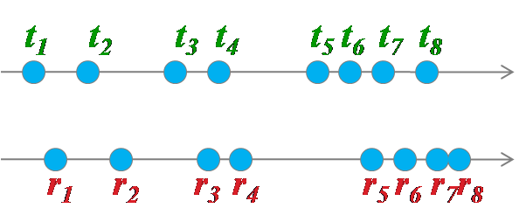
New Method II:
Dynamic Time Warping with Slope (DTWS)
Compare the slope correlation instead of the timestamp/interval correlation.
  Each “slope” (or so called delay) is the timing difference between a packet from reference stream and a packet from target stream
Suppose we are checking at point r₅ and t₄

Slide 61
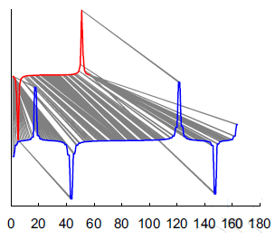
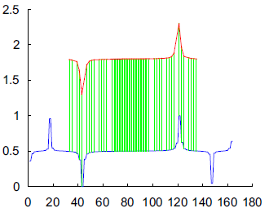
New Method III:
Optimal Slope Alignment (OSA)
Assumes both reference and target streams may contain outliers.
  Reference sequence is shorter than or equal to target sequence
    Allows to skip outliers in the target stream
    Treats the outliers in the reference stream as the penalties
DTW
OSA

Slide 62
New Method III:
Optimal Slope Alignment (OSA)
The calculation in a OSA method uses the following function:
For an example: Suppose p=5 and q=4
We can multiply a penalty factor if k=q

Slide 63
New Method III:
Optimal Slope Alignment (OSA)
Warping Function:
Time Series T
(Target)
1
q
m
1-1 mapping
w/o penalty
Treat as penalty
1
0 0 0 0 0 0 0 0 0 0 0 0 0 0 0 0 0
Time Series R
(Reference)
 |  |  |  |  |  |  |  | O
OSA(p,q)
p
OSA allows the reference stream R to match to only a subsequence of the target stream T
  skips outliers in T and treats outliers in R as the penalties during the matching process
  many to one mapping
  Time Complexity: O(nm²)
n
Dis(R,T)=min{OSA(n,s)|s=1, …m}
May not be at OSA(n,m)

Slide 64
Experiment Design
The collected traffic contains 6 stepping-stone hosts
  The number of hop denotes the distance between the hosts.
Of all combinations on each hop, there are 30 streams (attacker i to victim j) which serve as stepping-stone attack connections and the rest of 60 (attacker i to victim j where i ≠ j) streams acting as normal connections.
The threshold to distinguish between normal and attack is estimated via 5-fold cross validation.
Notes:
The collected data contains 30 (3 users times 10 collections) chains with 7 traffic flows (from 0 hop to 6 hop).

Slide 65
Performance w/o Evasion Techniques
The figure shows the worst case
  Each attack point represents the maximum dissimilarity score of 30 comparisons
  Each normal point represents the minimum dissimilarity score of 60 samples.
DTWW, DTWS, OSA can all find the gap of the dissimilarity score between attack and normal even up to 6 hops.
Dissimilarity Scores for DTWW, DTWS and OSA
(Y-axis uses log scale)

Slide 66
Performance with Evasion Techniques
With Clock Skew Involvement
  100% false rate: DTW
  23% false rate: DTWW
  0% false rate: OSSM, DTWS, OSA
With Chaff involvement
  Cannot tolerate chaff: DTW, DTWW, DTWS
  Tolerate up to 150% chaff: OSSM (4%FPR, 17%FNR)
  Tolerate up to 300% chaff: OSA (8%FPR, 0%FNR)
66

Slide 67
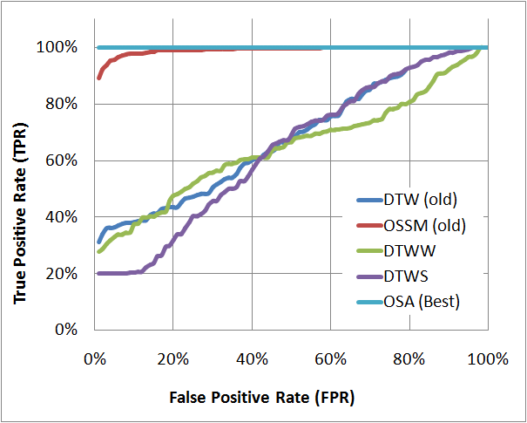
Performance with both
Clock Skew and Chaff Involvements
Results are taken from avg. of all the hops (0 to 6 hops) with a 0% to 200% chaff rate (50% CR increments) injected to the target streams.
Better
Methods
ROC curves for DTWS, DTWW, OSA, DTW and OSSM methods

Slide 68
Contents
Introduction
Stepping-Stone Detection
Stepping-Stone Correlation
Protection at the End of the Chain

Slide 69

End-of-Chain Protection
It is much more important for a host to protect itself from being a victim.

Slide 70
End-of-Chain Protection
Connection Chain
Attacker
Visible Hosts
Victim

Slide 71
Hypothesis
There is no valid reason for normal users to use a long connection chain for remote login such as SSH connection.
If we can discriminate long connection chains from short connection chains, then we can identify intruders from normal users.

Slide 72
Round-trip Time Can Be Used
If we can compute the round-trip time (RTT) of packets, we can estimate the length of the connection chain.
Computing downstream RTT is possible, but it is very difficult to compute upstream RTT.

Slide 73
Downstream RTT
Host 1
Host 2
Host 3
Host 4
Request
RTT
Reply
Time
Measuring downstream RTT is feasible.
But measuring upstream RTT is very difficult.

Slide 74
Upstream RTT
Host 1
Host 2
Host 3
Host 4
Request
T_{e}
Client
Server
Reply
?
Request
T_{s}
Time
Unknown time gap between previous reply and the next request can be one problem.

Slide 75
Another problem of Upstream RTT
Host 1
Host 2
Host 3
Host 4
Client
Reply
Server
Cross over
Gap1 < RTT
Gap2 < RTT
Cross over
Request
Time
Cross-over of reply and request packets is another problem.

Slide 76
What else we can use?
Is there any difference between short connection chains and long connection chains?

Slide 77
Sorted Short and Long Connection

Slide 78
Two Types of Packet Time Gaps
c
d
↵
l
s
↵
p
w
d
↵
(a) Inter-command gaps
c
d
↵
l
s
↵
p
w
d
↵
(b) Intra-command gaps

Slide 79
Comparison Between Short and Long Connection Distribution
Distribution of Intra-command gaps only
Distribution of Inter-command gaps only

Slide 80
Using uRTTs of Short Chains to Build a Profile.
Any extracted curves from new collected connection packet stream will be compared with this profile distribution to quantify the difference.

Slide 81
Absolute Difference
gp is the distribution of uRTT gaps of the profile chain.
g is the test connection’s distribution.
This distance measure takes the absolute distance between the profile distribution and any test connection distribution based on inter-command time gaps.

Slide 82
Separate Short Chain From Long Chain by Absolute Difference
Absolute difference method works very well for this kind of cases.

Slide 83
Short uRTT Curve with Large Distance
Absolute difference method works not well for this kind of cases.

Slide 84
Median of Ratio Adjustment
A ratio R is used to adjust and compensate distribution with different average typing speed.
Short connection curves under the profile curve will get the ratio R greater than one which can decrease the distance from the profile curve by calculating DR.
But long chain may get also get decreased distance with the R less than one.

Slide 85
Weighted Ratio Adjustment
S and Sp are the slopes of their uRTT distribution curves by linear regression (y=S*x + c).
Most long connection chains will get a weight larger than 0 which gives an increased distance Dw.
Using this adjustment, most long chains will have a bigger chance to hold an increased distance.

Slide 86
Comparison of three methods
Using median of ratio adjustment, the original long chain is moved close to the profile curve.
By assigning a weight to the ratio, the adjusted curve will be moved up to hold a large enough distance to be detected.

Slide 87
Validation: Classifying 4-hops Chains
20 sessions of 1-hop connection chains and 20 sessions of 4-hop connection chains are compared.
For different false positive rate, leave-one-out cross validation is used to select the threshold to calculate the true positive rate.

Slide 88
Classifying 4-hops and 6-hops Chains with Weighted Ratio Distance
Using weighted ratio adjustment, all 4-hops and 6-hops chains can be successfully classified when the FP is getting 15%.

Slide 89
Conclusion
Our method of detection centers on utilizing the packet stream of incoming connections to build inter-command gaps curve.
By using new connection distribution compared with a profile of short connection chains, it is possible to detect long connection chains with certain threshold.
Our experiments show that by tolerating a false positive rate of 15%, 100% of the test cases (4-hop and 6-hop) can be correctly detected with our weighted ratio distance measurement.

